Slide 1





A Vulkan Component based Rendering Library
Author: Alain Galvan
agalvan@fiu.edu
Mentor: Francisco Ortega
fortega@fiu.edu
Instructor: Masoud Sadjadi
sadjadi@cs.fiu.edu
TA: Mohsen Taheri
mtahe006@fiu.edu

Slide 2

Obsidian is a C++ Vulkan powered component based rendering library inspired by React Native.

Slide 3
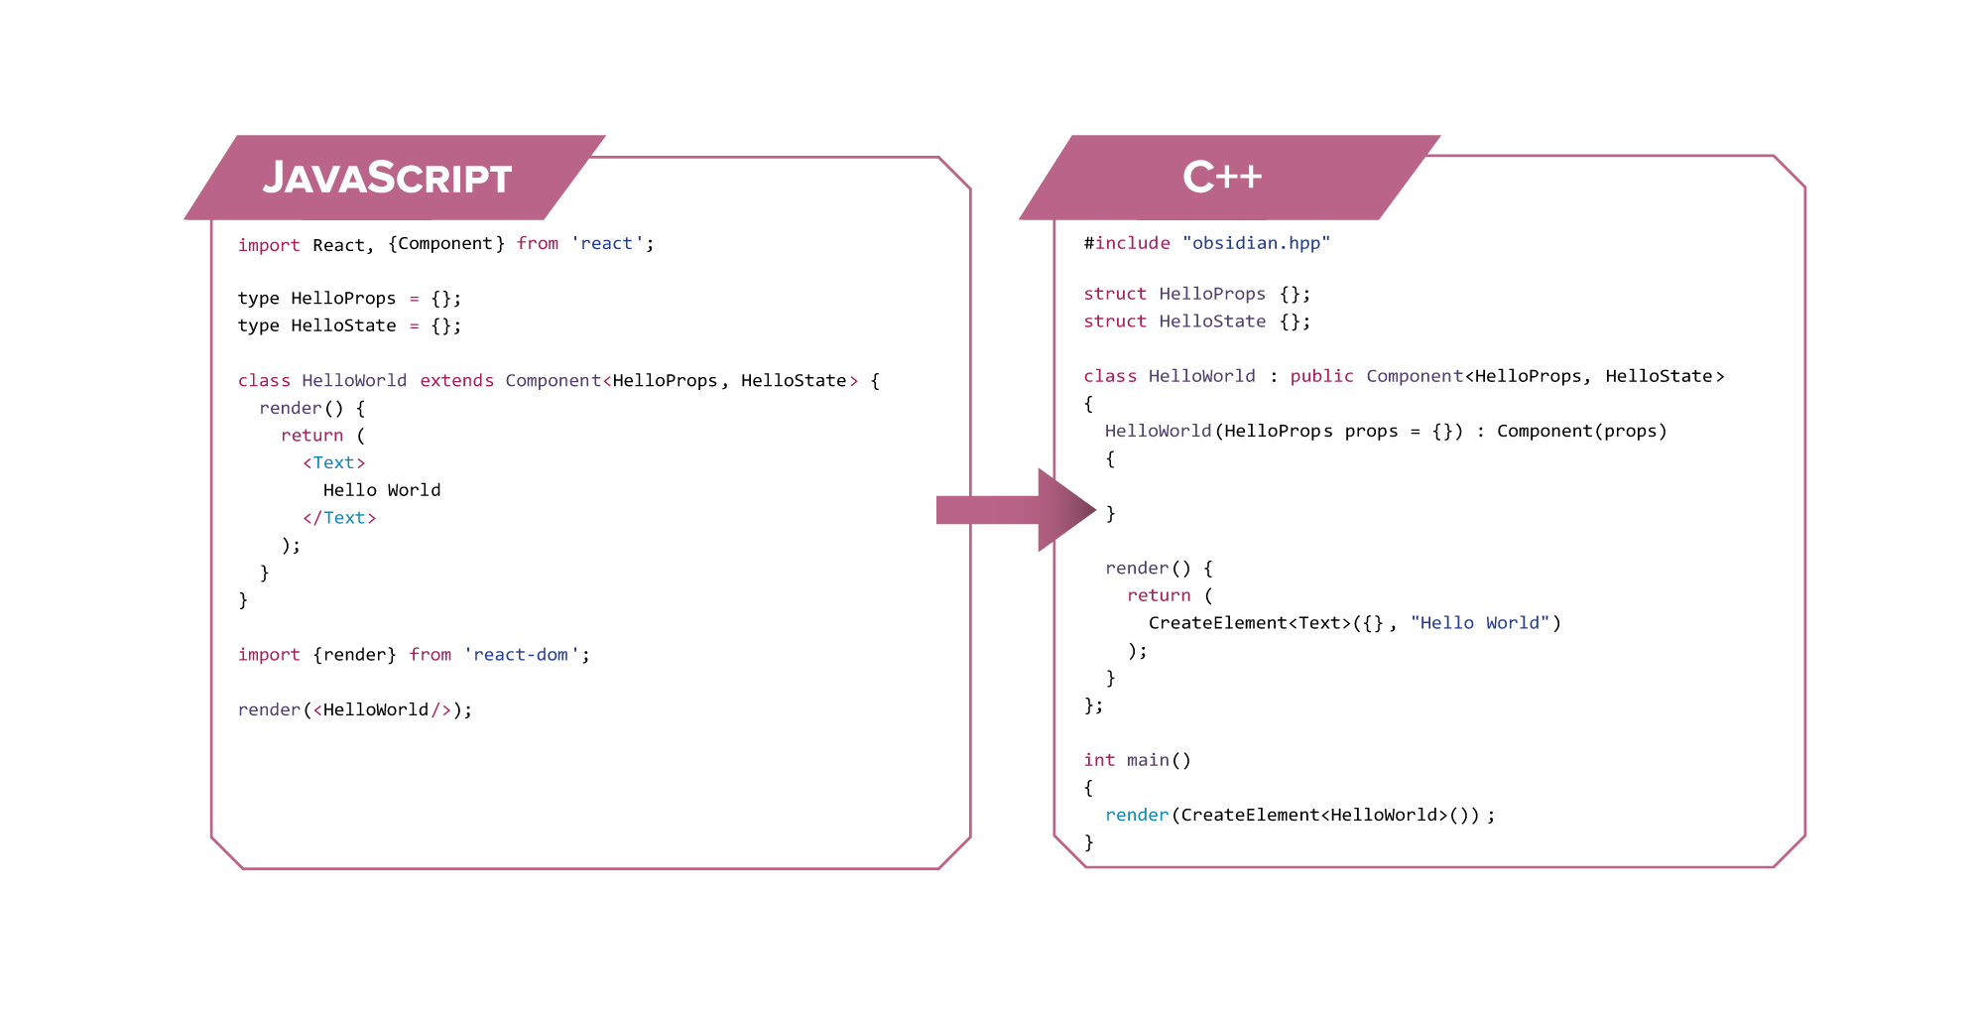

Slide 4
Prior Art
Component based Architectures - Instead of using a Domain Specific Language you compose your application as functions which return factories that build a descriptor graph.
React
React Native
Inferno
Ocaml / F# Trees
The application renderer is then responsible for rendering the tree description, and managing propagating updates through nodes.

Slide 5
Architecture
Package Management - Conan.io manages all our dependencies.
Template programming - For compile-time type safety , zero runtime, and variadic types.
Factory Functions - avoid new, allows custom allocation schemes.
Actor Model - Components are independent actors in an application.
^{|- docs/} ^{|- src/} ^{|- core/} ^{|- component.hpp}
^{|- factory.hpp} ^{|- utils.hpp}
^{|- components/} ^{|- win32.hpp}
^{|- material.hpp} ^{|- mesh.hpp} ^{|- view.hpp} ^{|- config.hpp} ^{|- provider.hpp}
^{|- obsidian.hpp} ^{|- tests/} ^{|- conanfile.txt} ^{|- readme.md}

Slide 6
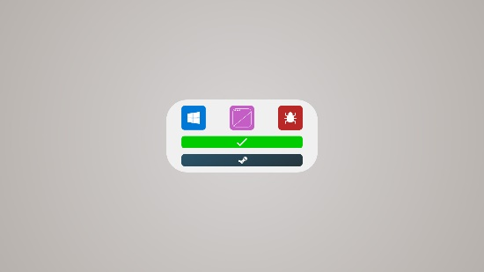
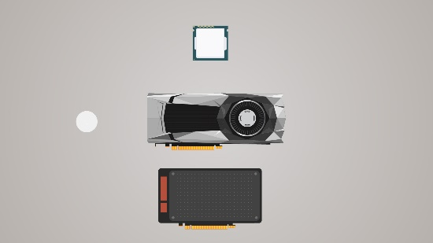
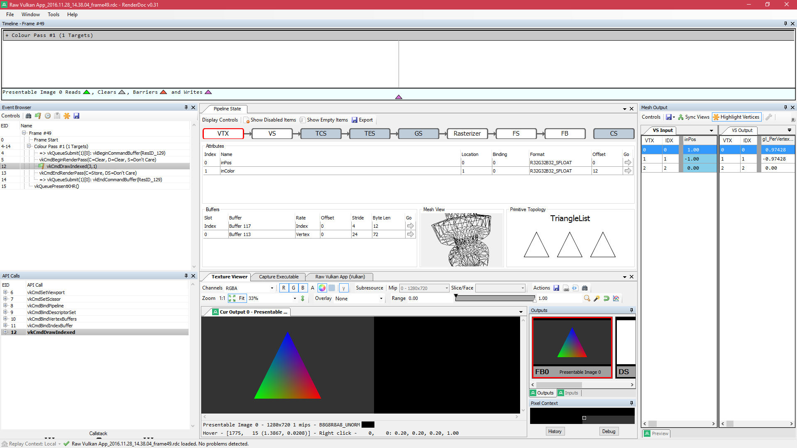
Results
Obsidian is semantically equivalent to React, however for closer integration a “cppx” compiler would be necessary, or integration with XAML similar to WinRT.cpp.
Vulkan constructs are composed to build simple view components similar to HTML.
Vulkan constructs can also be used to make game engine objects like environments and models.
RenderDoc debugging proved essential to profiling performance and tracking errors.

Slide 7
Benchmarks
Machine Specs: Alienware Area 51 | Nvidia 980 GTX | i7 5900K @ 3.6 Ghz Hex Core | 32 GB Ram

Slide 8
Burndown
Burndown Todo – setup burndown chart. I guess visit mingle and check?

Slide 9
Future Work
Shims for other low level graphics APIs such as OpenGL or DirectX 12.
A C++ constexpr shader compiler distributed as a part of the library.
Cross platform compilation to Android and Linux targets, with other platforms supported with shims.
___________________________________________________________
SHIRAEF, J. 2016. An Exploratory Study of High Performance Graphics Application Programming Interfaces. University of Tennessee.
FISHER, B. 2015. Flux: A Unidirectional Data Flow Architecture for React Apps. Applicative 2015.

